Slide 1

FINAL PROJECT: DATA-602 TITLE PREDICTIVE MODELLING OF RESPIRATORY VIRUS HOSPITALIZATION TRENDS UNDER THE SUPERVISION OF PROF. MASOUD SOROUSH
Team 1 : Raja Pavan Kalyan, Bala Sai Santhoshi, Venkata Sai Swaroop, Kesari Nandan and Ruchita Das

Slide 2

Section 1: Introduction & Exploring the Dataset
Section 2: Handling Missing Values
Section 3: EDA
Section 4: Feature Selection
Section 5: Model Comparison and Analysis
CONTENT

Slide 3
Introduction
The COVID-19 pandemic has profoundly affected global health systems all over the world.
Accurate forecasting of hospitalizations is essential for effective resource allocation and management of the healthcare system.
Why We Choose This Project?
This project was chosen to improve how health resources are allocated and managed during the COVID-19 pandemic.
Accurate forecasting of hospitalizations is essential for optimizing resource allocation and enhancing preparedness and response strategies.
Goal of This Project
The goal of this project is to develop predictive models that forecast COVID-19 hospitalizations using data provided by the Centers for Disease Control and Prevention (CDC) on the website cdc.gov
By doing so, the project aims to help healthcare systems in the United States allocate resources more effectively and manage healthcare services more efficiently during the pandemic.
This will ultimately improve health outcomes and reduce the impact of the pandemic in the future.

Slide 4
Data set
Dataset Source: Respiratory Virus Response (RVR) - United States Hospital Data downloaded in Jan-2024
Dataset Link: CDC RVR Dataset
Number of Rows: 20,000
Number of Columns: 115
Dataset Description:
The dataset contains information provided by hospitals to the National Healthcare Safety Network (NHSN).
It includes aggregated counts detailing metrics related to hospital admissions, as well as occupancy levels for inpatient and ICU beds.
This comprehensive dataset offers valuable insights into hospitalization trends and healthcare resource utilization during respiratory virus outbreaks, including the COVID-19 pandemic.

Slide 5
Determining the Basic Information of Dataset
Content:
Shape of the Data:
Number of Rows: 20,011
Number of Columns: 115
Column Names:
List of column names in the dataset.
Data Types:
Overview of data types present in the dataset.
Descriptive Statistics:
Summary statistics of numerical columns:
Mean, standard deviation, minimum, maximum, etc.
Column Types:
Identification of columns with non-numeric data types.
Numeric Columns:
Identification of columns with numeric data types.
Duplicate Rows:
Detection of duplicate rows within the dataset.

Slide 6
Handling the missing values
-Check for the null values -Calculate the missing value percentage -Identify and remove columns with more than 50% missing values -And then preprocess the data -Removing highly correlated columns

Slide 7
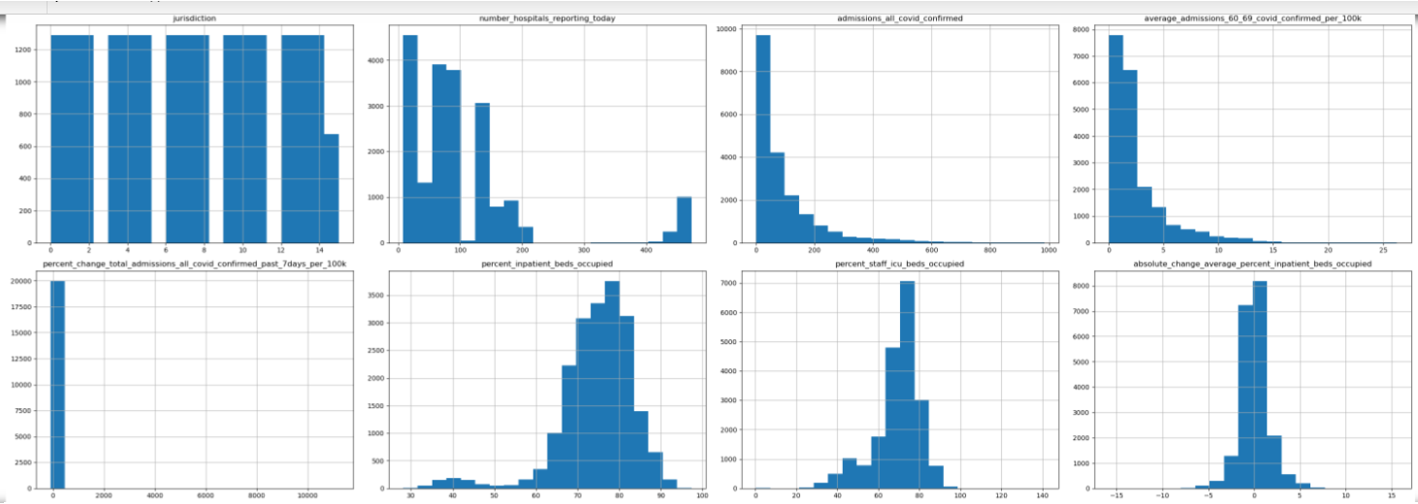
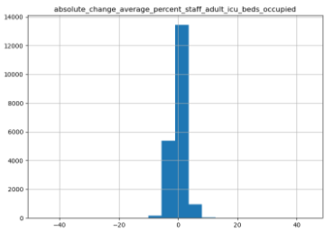
Exploratory Data Analysis:
These histograms visualize the distribution of various healthcare metrics, including COVID-19 admissions, hospital reporting rates, and ICU bed occupancy.
The plots reveal patterns and trends in pandemic-related healthcare utilization, helping identify changes in resource usage and potential outliers for effective resource planning.

Slide 8
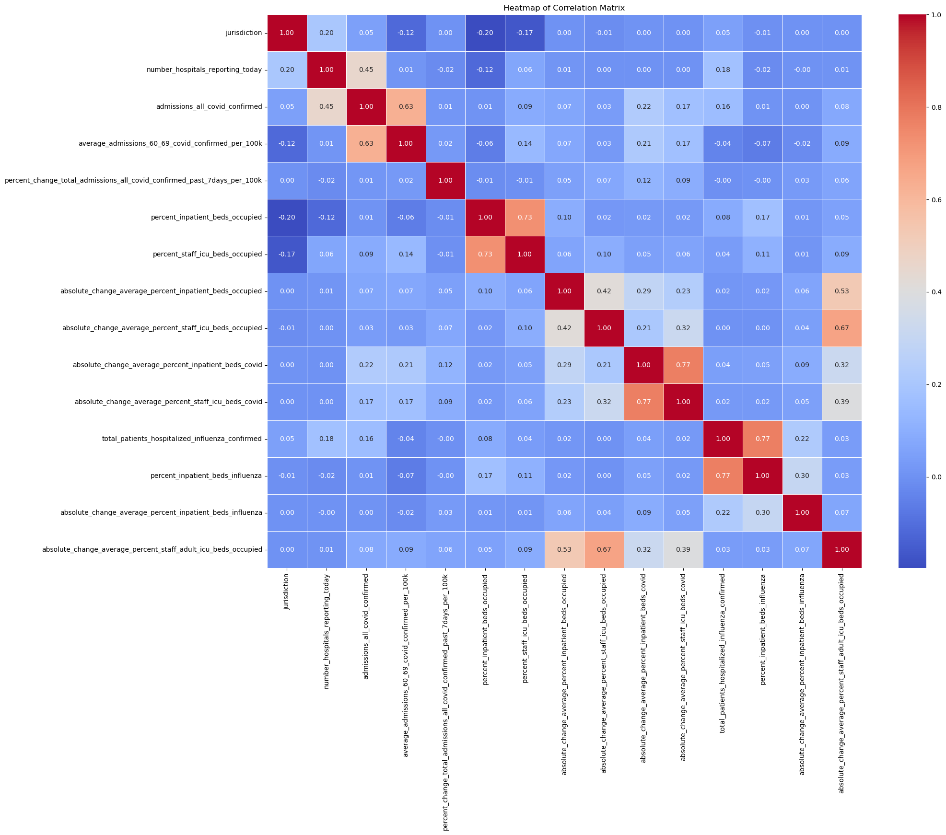

Slide 9
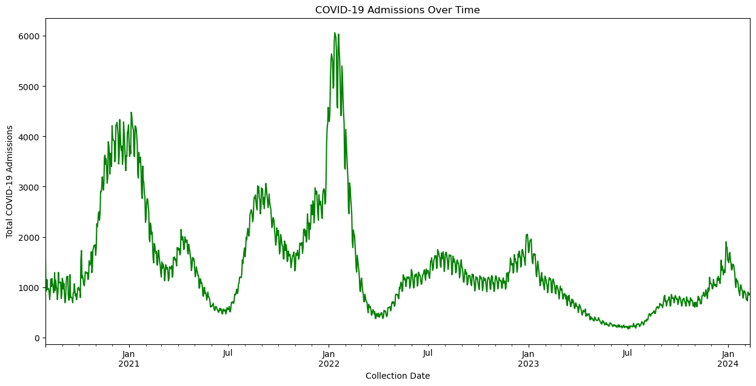
The graph shows the cyclic pattern of COVID-19 admissions over time, with distinct peaks representing various waves or surges of COVID from early 2021 to early 2024.
The visualization highlights both the magnitude and timing of these surges, providing insights into the pandemic's

Slide 10
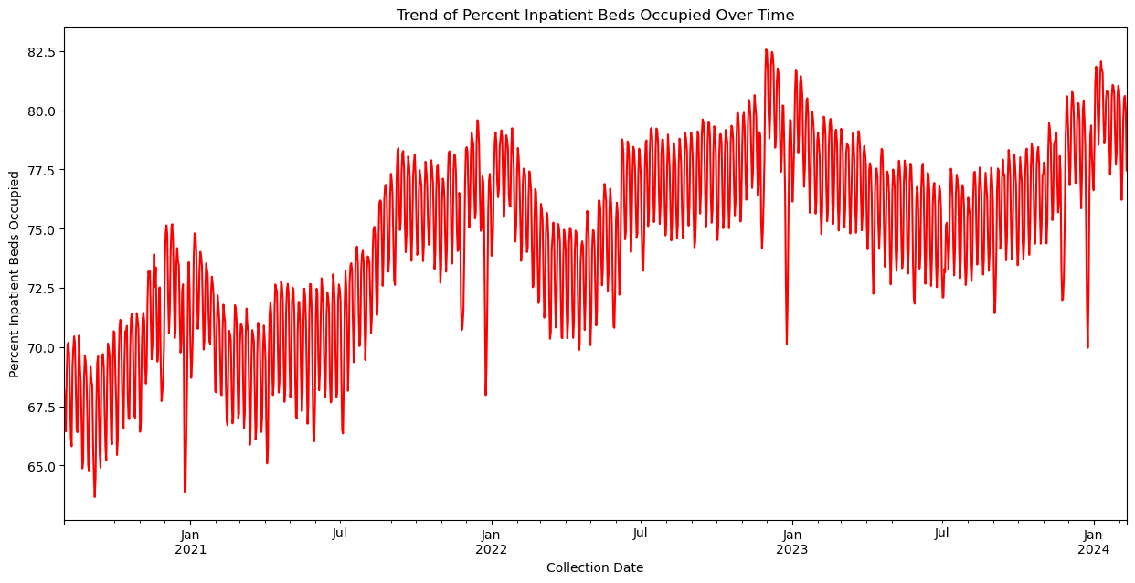
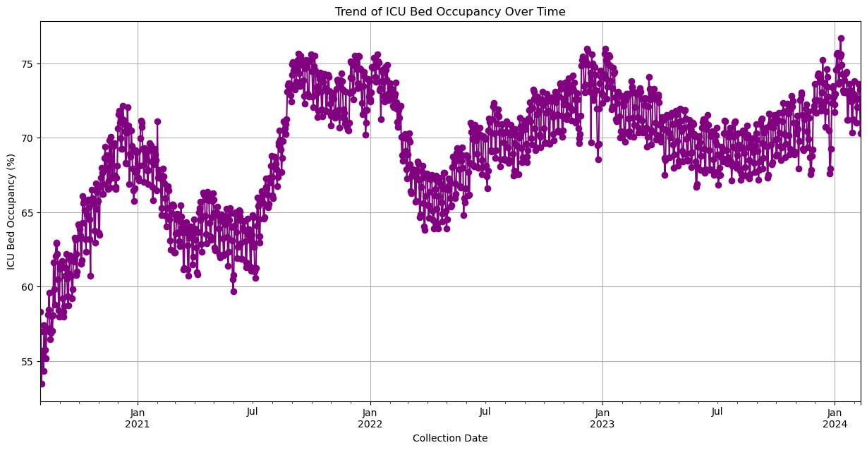

Slide 11
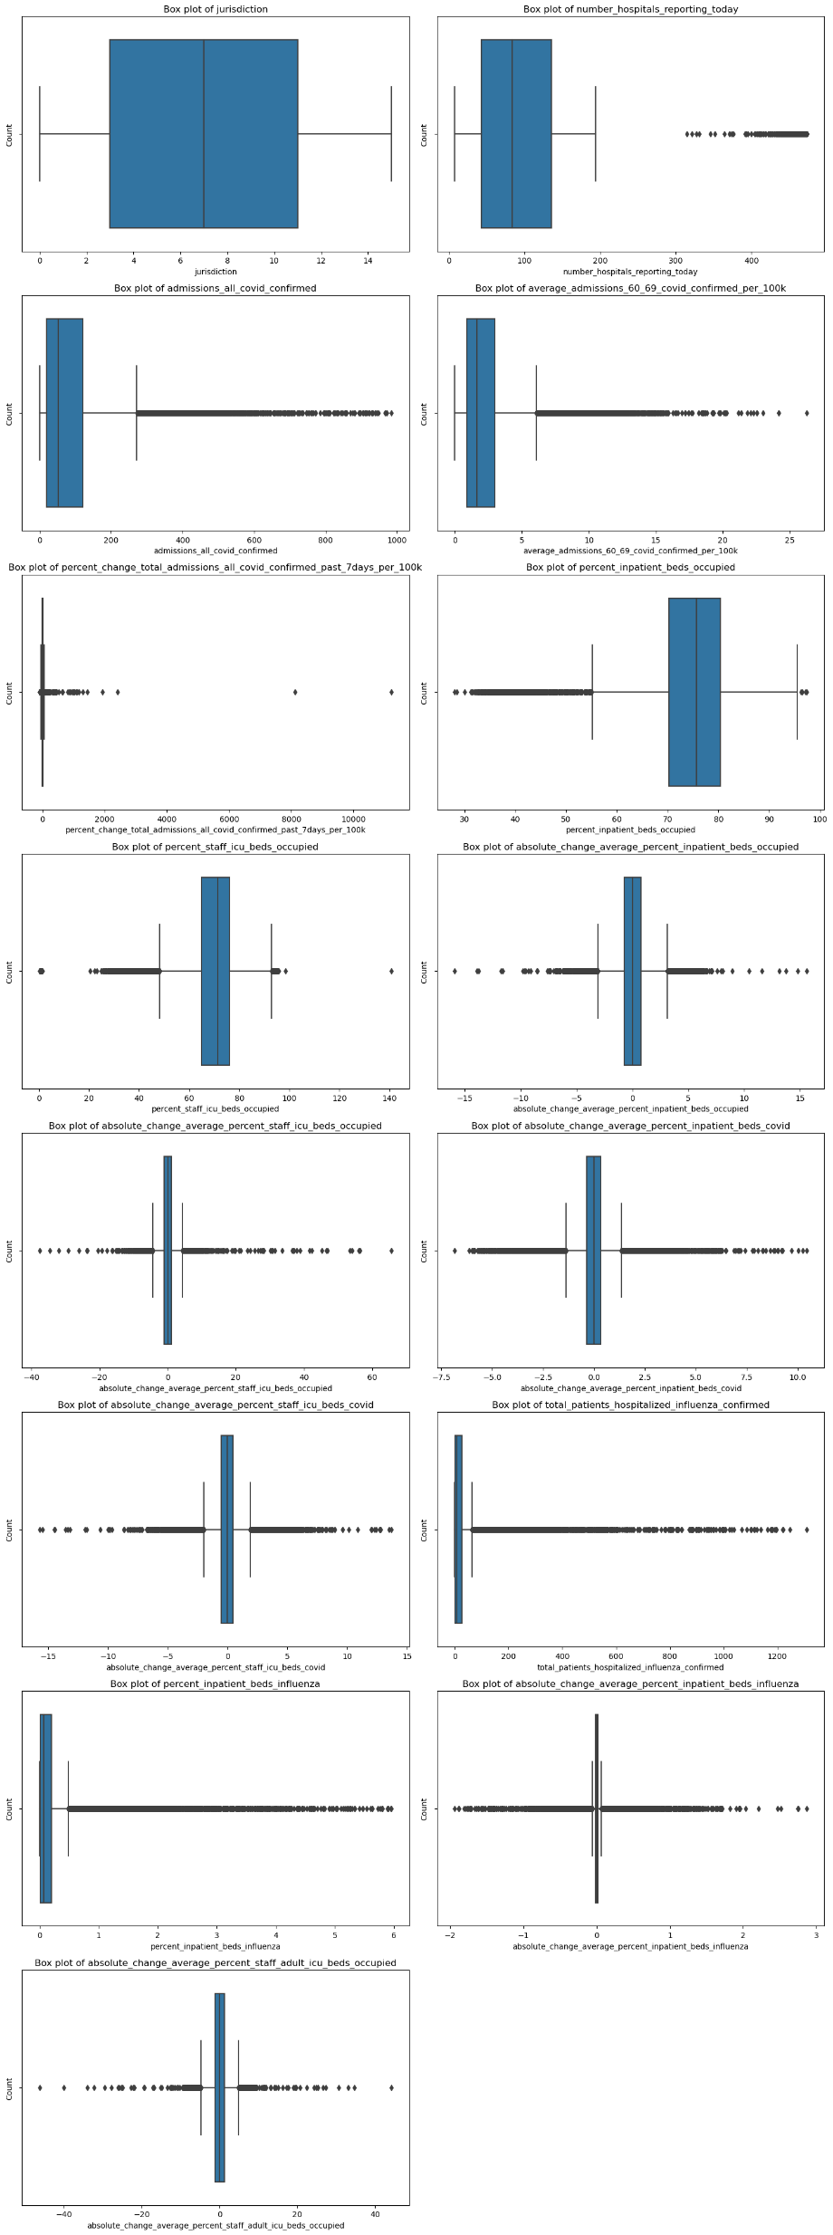
The box plots provide insights into the distribution of various healthcare metrics, showing the central tendency (median), spread (interquartile range), and presence of outliers for features like jurisdictions, COVID-19 admissions, and bed occupancy rates. This helps identify which features have skewed distributions and unusual data points that could affect analysis.
The plots show which data points may add noise to a predictive model, guiding the feature selection process.

Slide 12

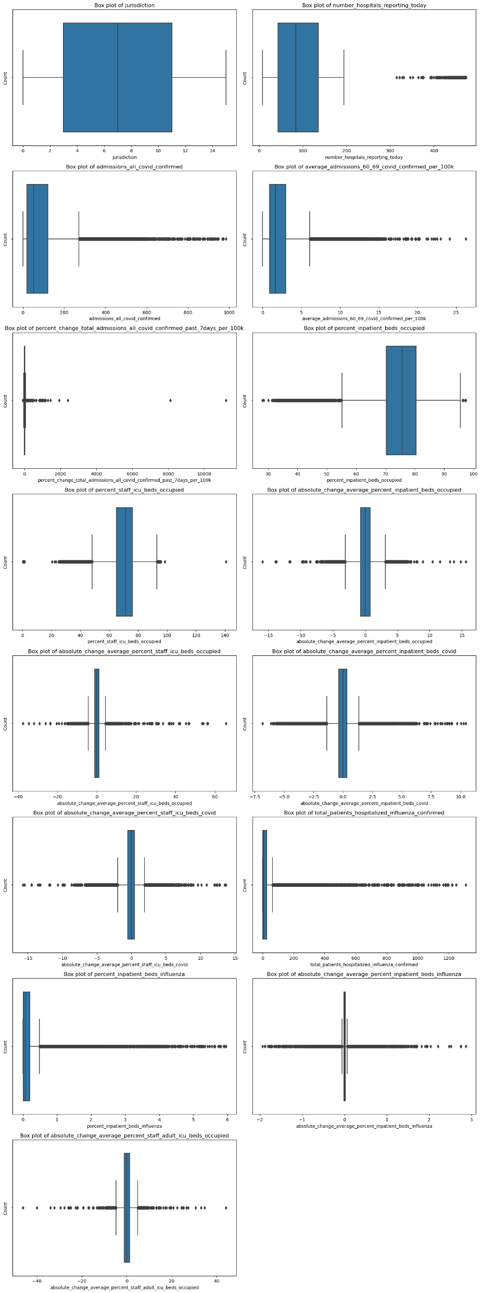



Slide 13
Section 4: Feature Selection
A) Correlation Analysis
Identifying Key Features: Selecting specific features based on correlation analysis and trend visualization for analysis and modeling.
1. Strong Positive Correlation (Absolute Value > 0.5):
number_hospitals_reporting_today: The number of hospitals reporting today has a strong positive correlation (0.6727) with admissions_all_covid_confirmed. This indicates that as the number of hospitals reporting increases, the count of confirmed COVID-19 admissions also tends to increase.
2. Moderate Positive Correlation (0.3 < Absolute Value < 0.5):
average_admissions_60_69_covid_confirmed_per_100k: This feature has a moderate positive correlation (0.6027) with admissions_all_covid_confirmed, suggesting that higher rates of COVID-19 admissions in the age group 60-69 per 100k population are associated with higher overall admissions.
total_patients_hospitalized_influenza_confirmed: There is a moderate positive correlation (0.3566) between this feature and admissions_all_covid_confirmed, indicating that higher counts of confirmed influenza hospitalizations are associated with higher counts of COVID-19 admissions.
3. Weak correlations (|correlation| < 0.3) were found with other features like "percent_inpatient_beds_occupied" and "percent_staff_icu_beds_occupied".

Slide 14
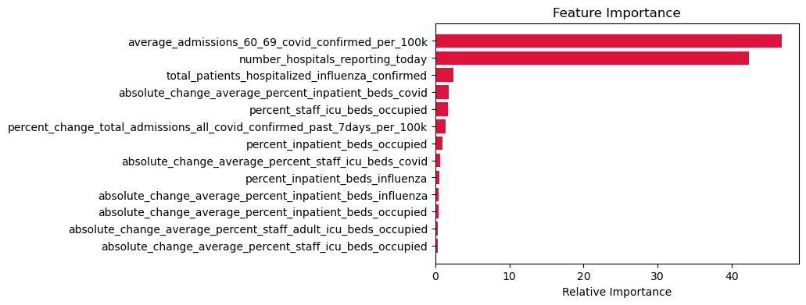
B)Features Selection through Random Forest Regressor
We selected the First 6 features for further evaluation.

Slide 15
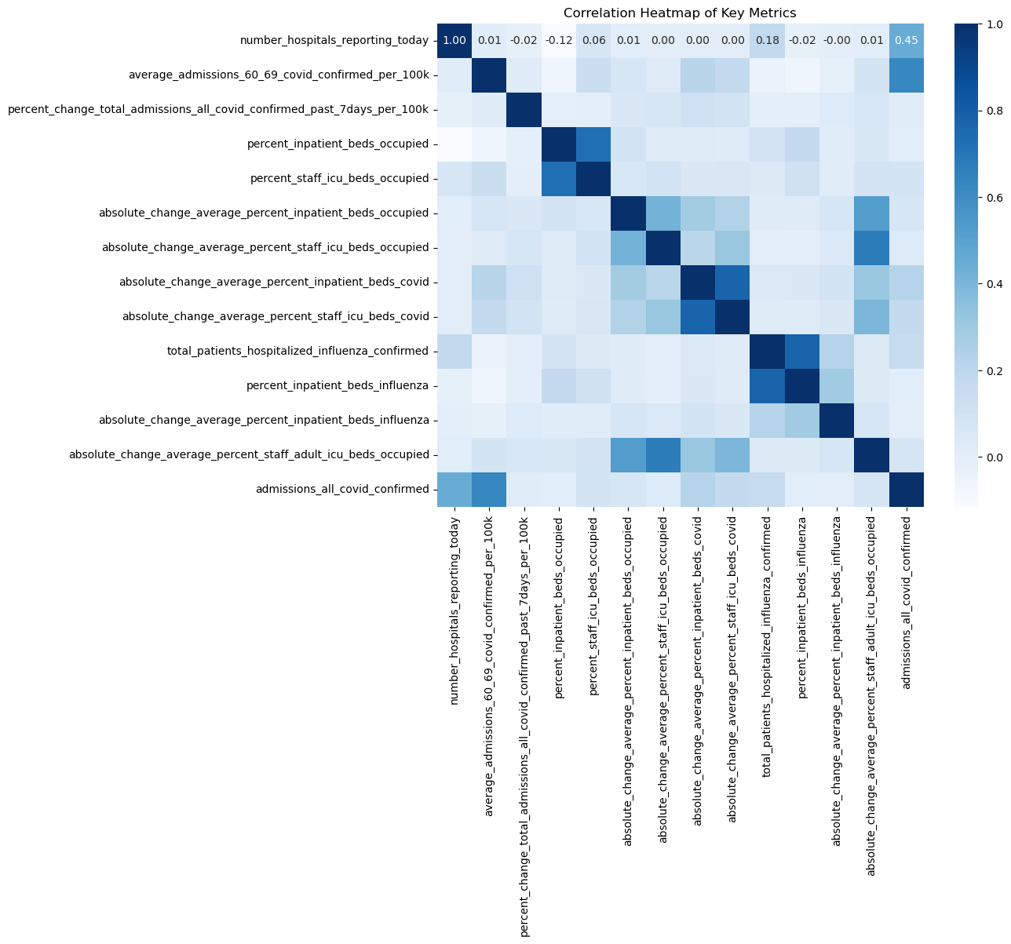
C) Heatmap

Slide 16
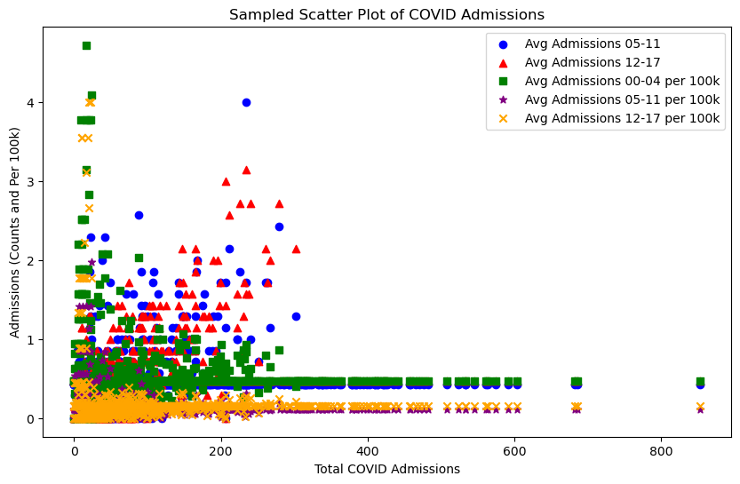
There does not appear to be a clear trend or correlation between the total COVID admissions and the average admissions for these pediatric age groups when adjusted per 100k.

Slide 17

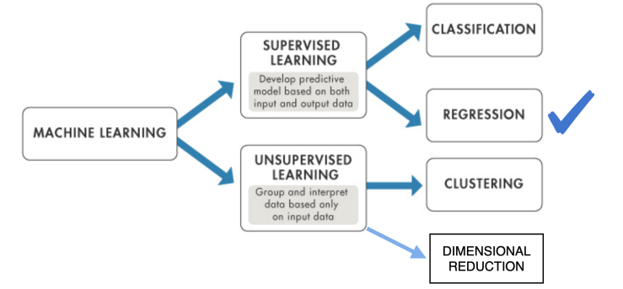
Models Selected for Analysis
A) Regression
1. Linear Regression
2. Polynomial Regression
3. Decision Tree
4. Random Forest
5. Gradient Boost
6. Ada Boost
7. XG-Boost
8. SV Regression
9. Stacking
B) Neural Networks
1. Classic Neural Network
2. CNN

Slide 18
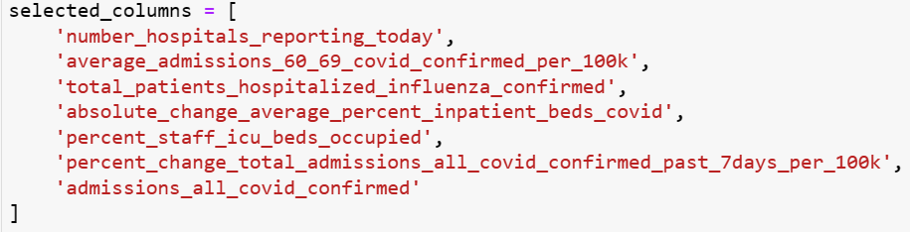
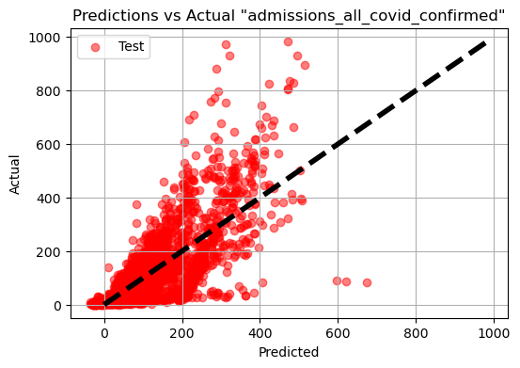
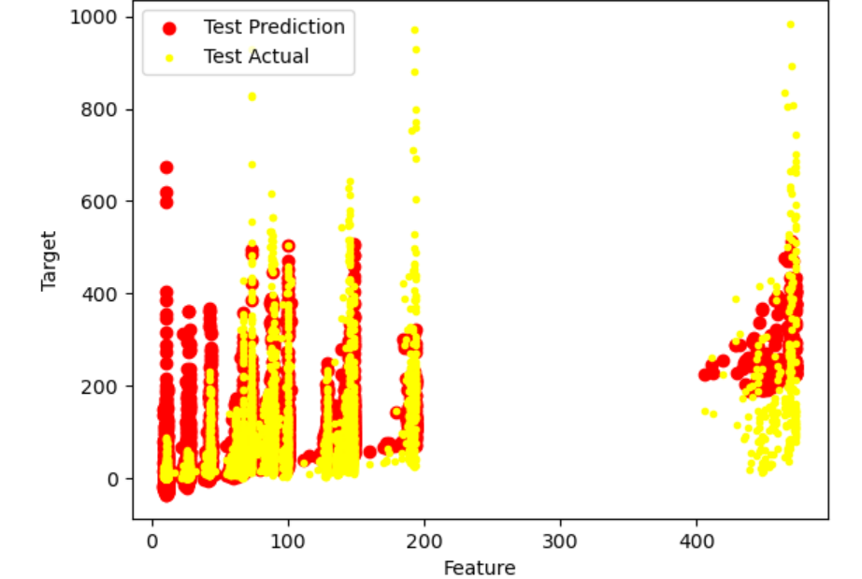
1. Linear Regression
Models | R2 Train | R2 Test
Linear Regression | 0.6098 | 0.6133
Ridge Regression | 0.6097 | 0.6133
Lasso Regression | 0.6105 | 0.6085

Slide 19
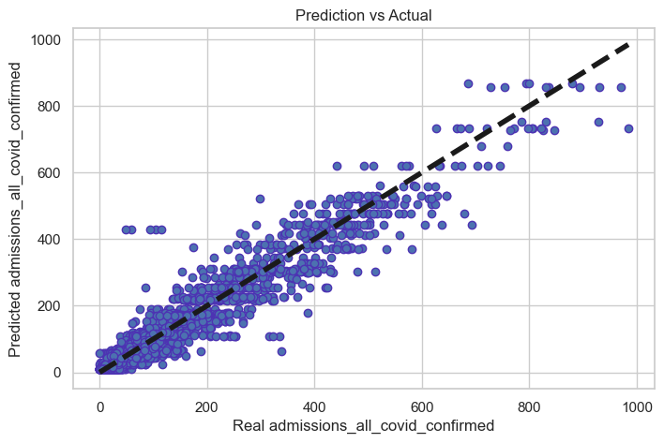
2. Decision Tree
Root Node
Node 1
Node 2
Leaf 1
Leaf 2
Leaf 3
Results Before Tunning
Tunning Hyperparameters
Results After Tunning
R2 Train = 1.0
Max Leaf Nodes: 99
R2 Train = 0.94
R2 Test = 0.94
Min Samples Split: 4
R2 Train = 0.93

Slide 20
Polynomial Regression Model Analysis
Model Overview:
Polynomial Degree: 2
Purpose: Enhance model fit by capturing non-linear relationships.
Performance Metrics:
Training Data R²: 0.8102
Testing Data R²: 0.8081
Note: Consistent scores suggest a balanced model without overfitting
Key Coefficients & Intercept:
Highlight a few impactful coefficients (e.g., First coefficient: 0.887)
Intercept: 14.8749
Conclusion:
The polynomial model shows strong performance and predictive reliability.
Considerations for further analysis might include exploring higher-degree polynomials or additional feature engineering.

Slide 21
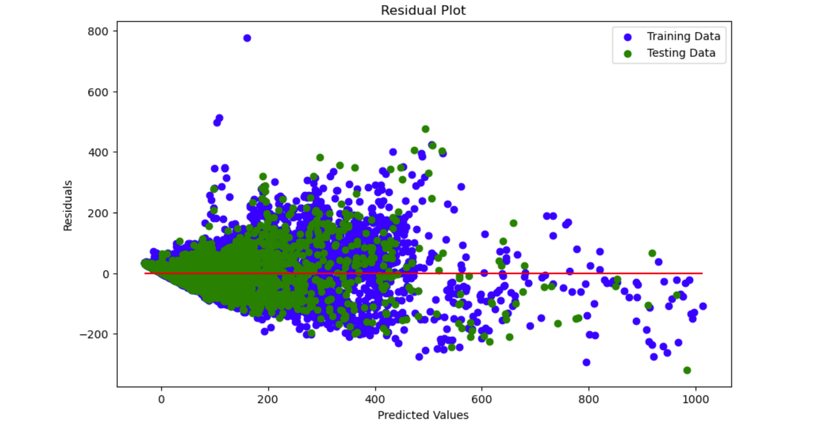

Slide 22
Random Forest Regression Model Optimization
Model Overview
Initial Model Performance:
R² Score: 0.9664
Demonstrates a high degree of accuracy in predictions using the original set of parameters.
Parameter Tuning
Method: Grid Search CV
Parameters Tested:
Number of estimators: 100, 200
Maximum features: sqrt
Maximum depth: None, 10
Minimum samples split: 2, 5
Minimum samples leaf: 1, 2
Fitting Details:
3-fold cross-validation
Total of 48 fits, highlighting the best performance with max_features='sqrt' and min_samples_leaf=1.
Optimized Model Results
Optimized R² Score: 0.9643
Indicates slight decrease compared to the initial model but may offer better generalization.
Conclusion
The optimization process fine-tuned the model to potentially enhance robustness and prevent overfitting.
Further testing or inclusion of more diverse parameters in the grid search could be considered to explore additional improvements.

Slide 23
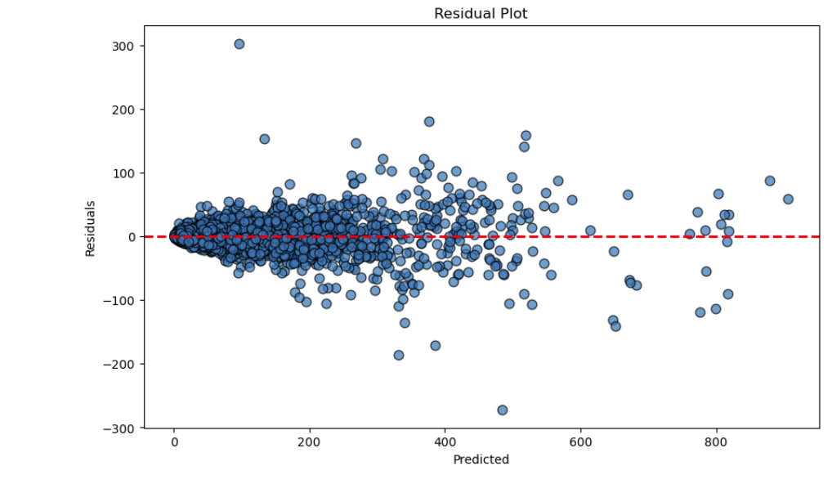

Slide 24
Optimization of Gradient Boosting Regressor
Model Overview
Initial Model Setup:
N Estimators: 100
Learning Rate: 0.1
Max Depth: 3
Initial R² ScorIe: 0.9376
Shows a strong predictive accuracy using default settings.
Hyperparameter Tuning
Method: Grid Search CV
Parameters Tested:
Estimators: 100, 200
Learning Rates: 0.1, 0.01
Max Depths: 3, 4
Minimum Samples Split: 2, 4
Minimum Samples Leaf: 1, 2
Optimization Details:
3-fold cross-validation, 96 fits total
Optimized to improve model's performance and adjust to dataset specifics.
Optimized Model Performance
Optimized R² Score: 0.9572
Demonstrates an improvement, ensuring the model is more accurate and robust after tuning.
Conclusion
Highlight the benefits of tuning Gradient Boosting models, like improved accuracy and potential for better generalization.
Suggest next steps, such as further parameter tuning or external validation.

Slide 25
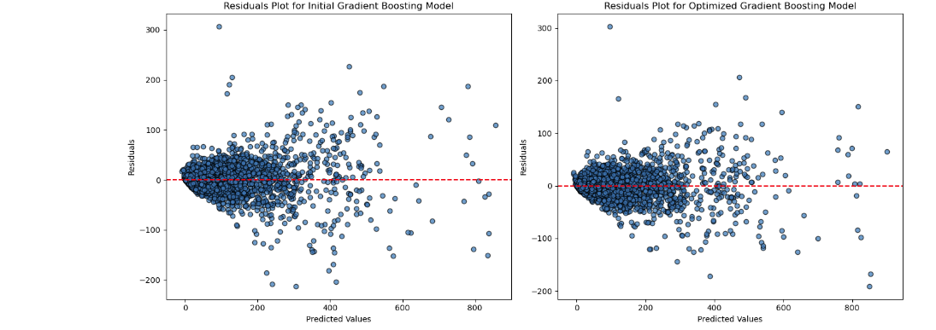

Slide 26
Optimization of AdaBoost Regressor
Initial Model Performance
Configuration:
N Estimators: 100
Initial R² Score: 0.3901
Indicates limited predictive accuracy with the default setup.
Hyperparameter Tuning
Method: Grid Search CV
Parameters Tested:
N Estimators: 50, 100, 200
Learning Rates: 0.01, 0.1
Loss Functions: Linear, Square, Exponential
Optimization Details:
Conducted with 3-fold cross-validation, 54 fits
Best Parameters Found:
Learning Rate: 0.1
Loss: Exponential
N Estimators: 50
Optimized Model Performance
Optimized R² Score: 0.8043
Significant improvement in model accuracy, demonstrating enhanced fit and generalization capability after optimization.
Conclusion
Emphasize the impact of parameter tuning on the performance of AdaBoost models.
Future steps could include testing additional parameter combinations or applying the model to a broader dataset.

Slide 27
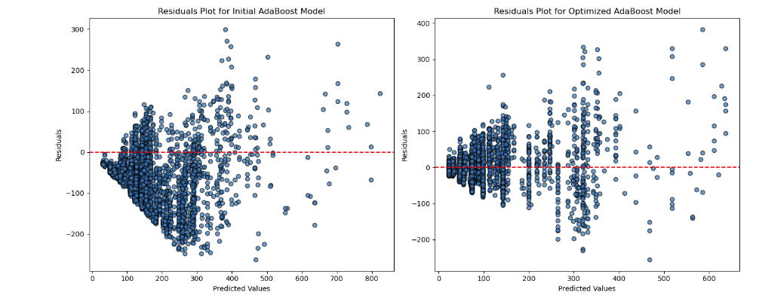

Slide 28
Evaluation of SVR Model with RBF Kernel
Model Overview
Kernel Type: RBF (Radial Basis Function)
Regularization (C): 1.0
Epsilon: 0.1
Objective: Explore the performance of SVR on the dataset.
Performance Metrics
R² Scores:
Training Data: 0.190
Testing Data: 0.198
Mean Squared Error (MSE):
Training Data: 11,430.691
Testing Data: 10,310.215
Explanation: The R² scores indicate that the model explains a small portion of the variance in the target variable. The high MSE values suggest significant prediction errors.
Insights & Observations
The performance metrics show limited predictive accuracy, which could be due to several factors including the choice of kernel, the need for feature scaling, or the underlying data distribution.
The slight improvement in testing R² compared to training suggests no overfitting, but overall low efficacy in predictions.
Conclusion & Recommendations
Given the low R² scores and high MSE values, exploring alternative models or tuning SVR parameters such as increasing regularization (C) or adjusting epsilon might be beneficial.
Consider preprocessing steps like feature scaling or more comprehensive feature engineering to enhance model performance.

Slide 29
Performance of XGBoost Regressor Model
Model Configuration
Objective: reg:squarederror
ColSample by Tree: 0.3
Learning Rate: 0.1
Max Depth: 5
Alpha (Regularization): 10
N Estimators: 100
Model Performance Metrics
R² Scores:
Training Data: 0.761
Testing Data: 0.752
Mean Squared Error (MSE):
Training Data: 3371.205
Testing Data: 3189.170
Explanation: The close R² scores between training and testing indicate good model generalization without significant overfitting.
Insights & Observations
The model demonstrates robust predictive accuracy with consistent performance on both training and testing sets.
The slightly higher MSE on training suggests that while the model is effective, there's room for optimization possibly by tuning hyperparameters or adjusting features.
Conclusion
The XGBoost model effectively predicts with a balanced fit across the training and test datasets.
Future steps might include experimenting with different hyperparameters, adding more data, or trying feature engineering to further reduce error.

Slide 30
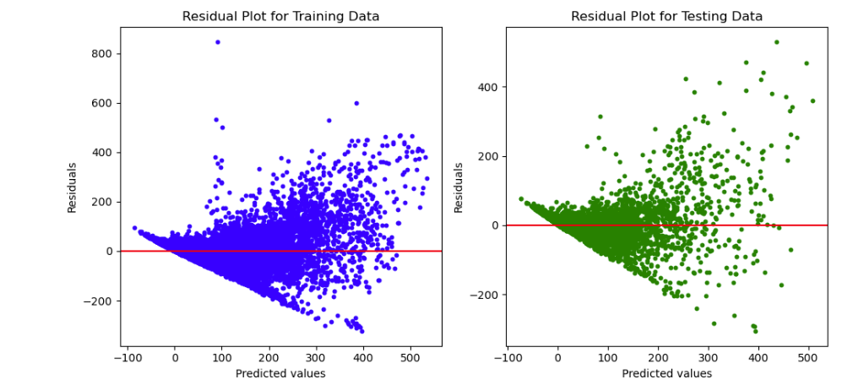

Slide 31
Detailed Interpretation of Stacking Classifier Results
Mean Squared Error (MSE): 445.66
What It Means: MSE measures the average of the squares of the errors—i.e., the difference between predicted values (hospital admissions) and actual values. An MSE of 445.66 suggests that the predictions are, on average, squared differences of 445.66 from the actual admissions figures.
Why It Matters: The lower the MSE, the closer the predictions are to the actual results, indicating higher model accuracy. Compared to the MSEs of individual models, if this value is lower, the stacking model has effectively reduced prediction errors.
Practical Interpretation: The square root of MSE (approx. 21.11) estimates the typical prediction error in terms of hospital admissions. This figure helps hospitals gauge the expected deviation in daily admissions forecast

Slide 32
Accuracy: 60.92%
What It Means: Assuming 'accuracy' here refers to an R² value, this percentage indicates that approximately 61% of the variability in hospital admissions can be explained by the model’s inputs.
Why It Matters: While not perfect, an R² of 60.92% is relatively substantial in complex, real-world scenarios like healthcare analytics, where predicting outcomes perfectly is often challenging due to numerous unforeseen factors.
Practical Interpretation: This level of accuracy means that the model is quite reliable for making informed decisions, allowing for better planning and resource allocation

Slide 33
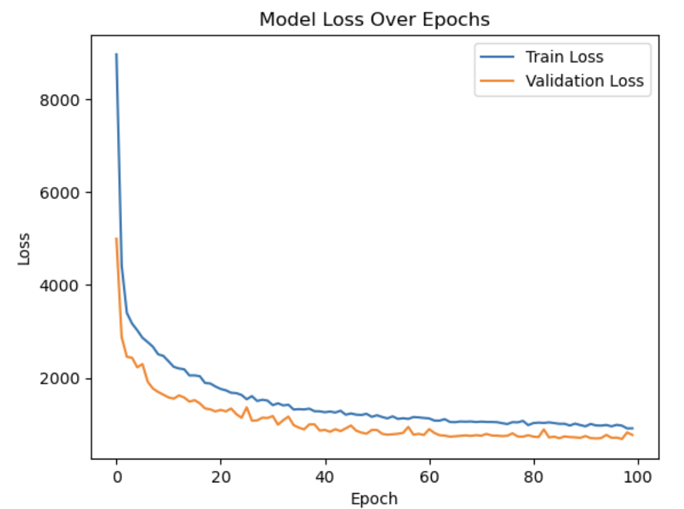
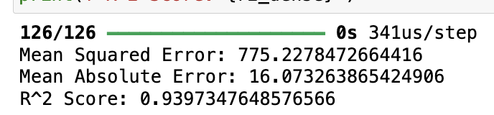
Classic Neural Network:
Training the model to achieve a mean squared error of 775.23, mean absolute error of 16.07, and an R^2 score of 0.9397, indicating high predictive accuracy.
From the graph we can see that the train loss decreases steadily over time. This suggests that the model is learning the training data well. However, the validation loss also starts to decrease, but then increases again after about 20 epochs.

Slide 34
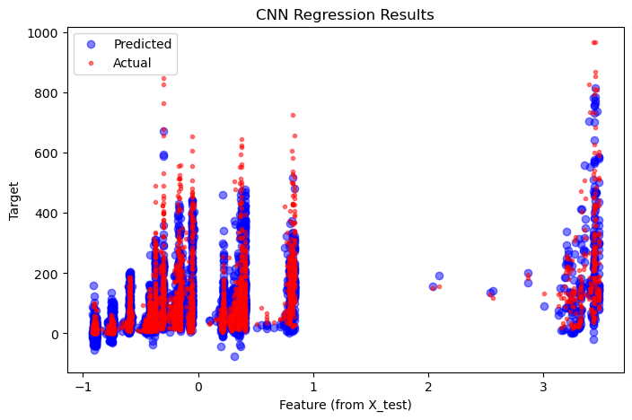
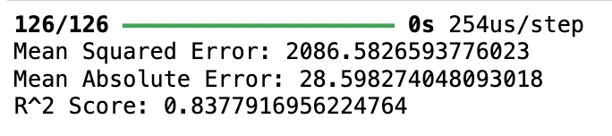
Convolutional Neural Network:​
The model is structured with convolutional, pooling, flattening, and dense layers. After compiling and training on scaled data, the model shows a test loss of 2086.5830. The mean squared error (MSE) calculated post-prediction is 2086.5826, the mean absolute error (MAE) is approximately 28.59, and the coefficient of determination (R² score) is about 0.8377. From the graph, we can see that the overlap of red and blue dots indicates where the model's predictions closely match the actual values. The separation of red and blue dots, particularly in areas where the red dots are far from the blue ones, suggests discrepancies between the predicted and actual values, indicating potential areas where the model does not perform as well.

Slide 35
Model Comparison:
Linear Regression: Served as a baseline with moderate accuracy. It helped us understand the direct relationships between features and hospitalizations but struggled with complex interactions.
Decision Tree: Provided better interpretability and managed non-linear relationships more effectively. However, it was prone to overfitting the training data.
Ensemble Methods: These models achieved the highest accuracy and robustness against overfitting. XG Boost, in particular, handled various data scales well and improved prediction through gradient boosting techniques.
Support Vector Regression (SVR): Performed well in capturing subtle patterns in data but required extensive parameter tuning for optimal performance.
Stacking Classifier: By combining multiple models, the stacking classifier leveraged strengths from various approaches, resulting in improved predictive power.
Classical Neural Network: While it was the most complex model, it showed promise in capturing intricate patterns in large datasets, although it required more computational resources and data.

Slide 36
Conclusion
Insightful Patterns Identified: Our models have identified that age and pre-existing health conditions are significant predictors of hospitalization due to respiratory viruses. Seasonal trends also play a crucial role, with spikes in hospitalizations typically occurring in the winter months.
Geographical Variations: There are notable differences in hospitalization rates across different states, indicating that local health policies and population density may influence these trends.
Resource Allocation: Our models can inform health authorities about potential spikes in hospitalizations, allowing for better resource allocation, such as beds and medical staff.
Policy Formulation: Insights from the models can guide public health policies, particularly in vaccination drives and public health advisories.

Slide 37
Thank you

